Slide 1
Kinematical model for arc-tomography of the cgm

Slide 2
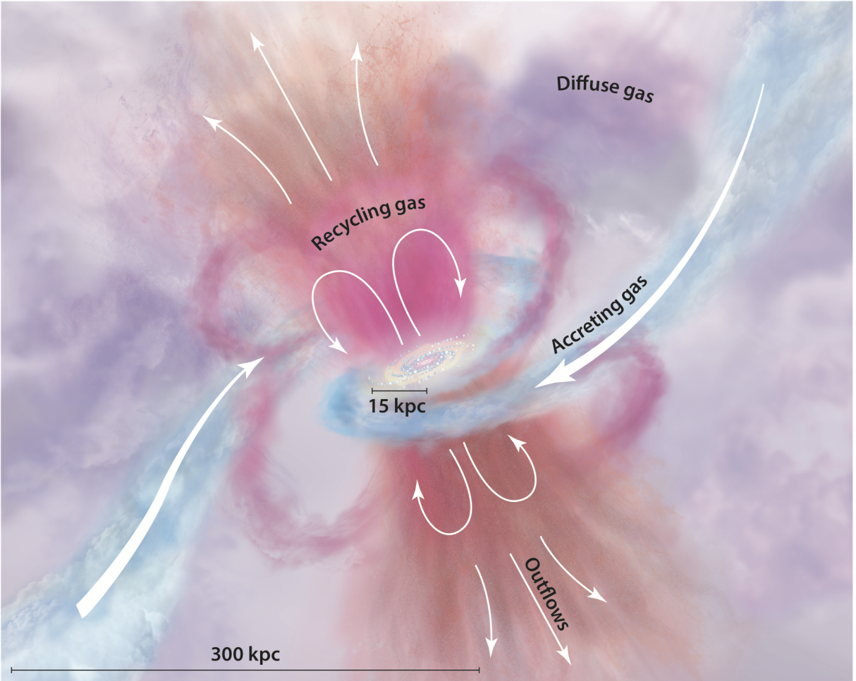
Circumgalactic medium
CGM: gas surrounding galaxies outside their disks and inside their virial radii
Important role in our understanding of galaxy evolution: Fuel for star formation
Tumlinson et. al (2017)

Slide 3
Arc-tomography
Use gravitational arcs as extended background sources
Get information about many different positions, unlike with QSOs

Slide 4
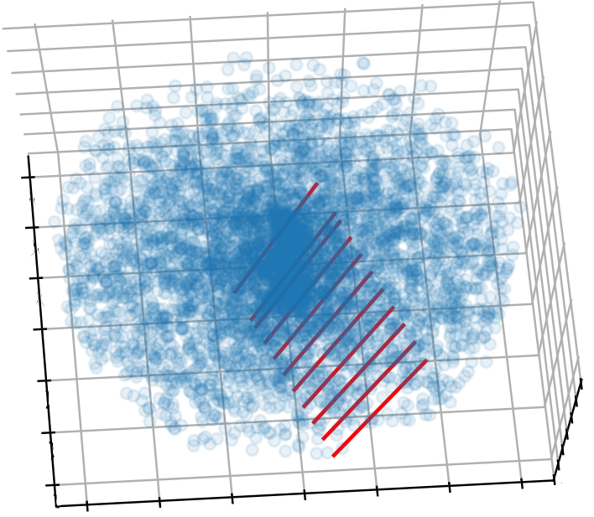
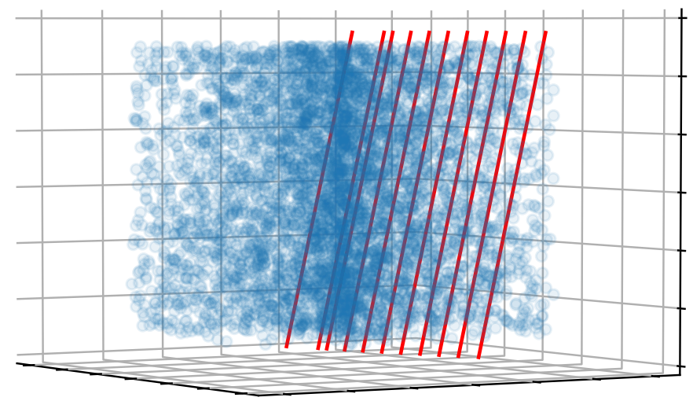
The model
Edge on view
Face on view

Slide 5
Model parameters
Geometrical:
Radius, R
Height, h
Inclination, i
Physical:
V_max
Scale height()
Turn over radius
Cloud parameters
cloud density function, radial profile probability (power law, A, index)
Cloud size
Column density
doppler parameter

Slide 6
Model inputs
Impact parameter
Azimutal angle
Absorption redshift (---> physical scale)
Spectral resolution
Beam size And shape

Slide 7
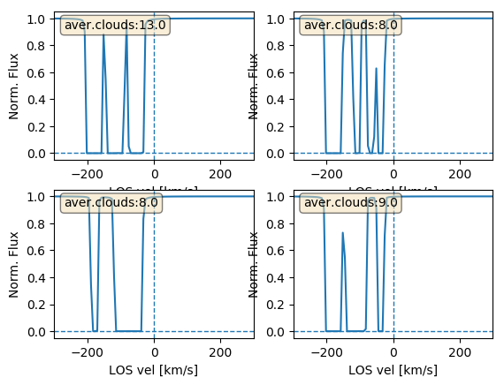
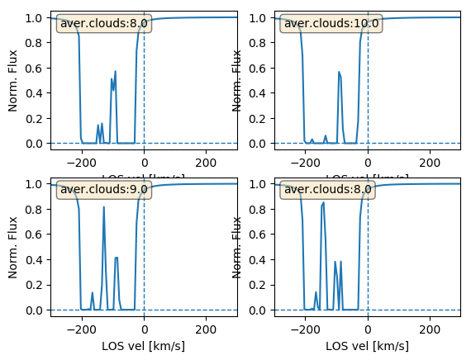
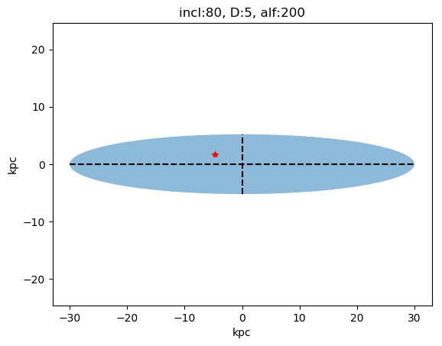
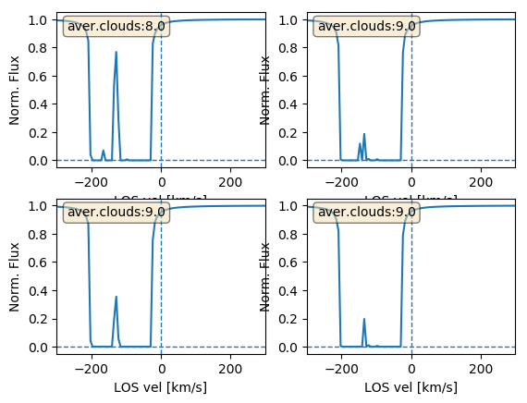
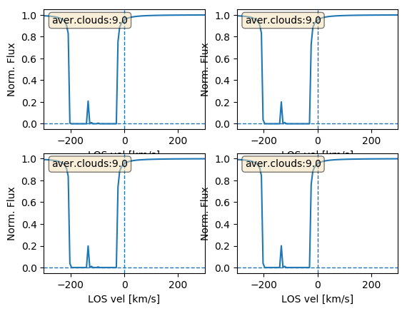
N=10^14, b= 5

Slide 8
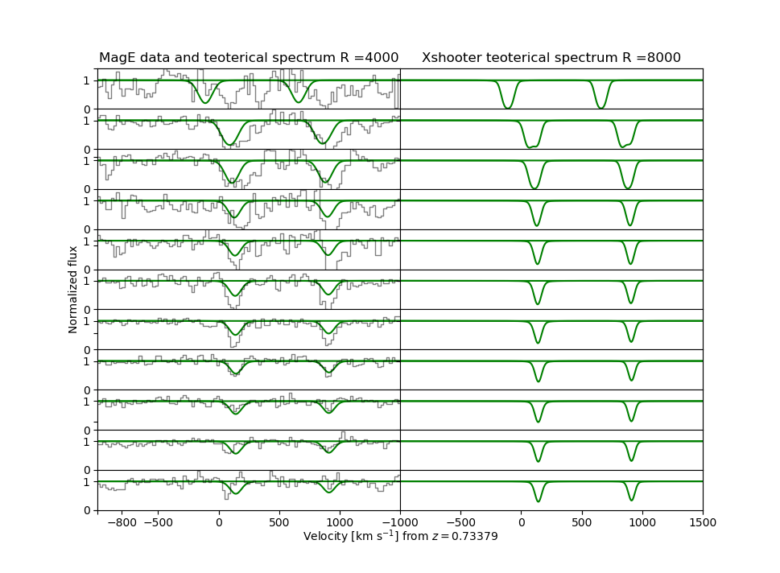
#1
#2
#3
#4
#5
#6
#7
#8
#9
#10
#11

Slide 9
Next
average spaxel
Fix coordinates
play with parameters

Slide 10
For my ESO stay
Create a synthetic cube
Compare this cube with the data
chi2 or MCMC

